Slide 1
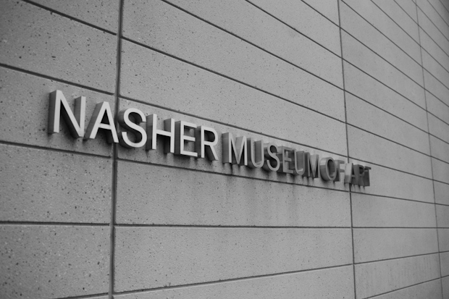
Coding the Collection:
Art of the Americas
Team: Will Ye, Edward Zhuang, Sam Chan, Santo Grillo
Clients: Julia McHugh, Mark Olson

Slide 2
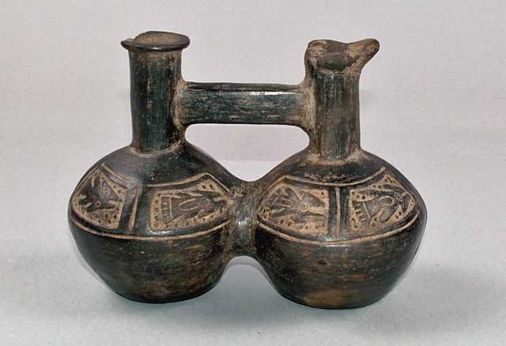
Problem
Visitor:
Sometimes want more information on artwork
Curator:
Not always able to display artwork in a way that “does it justice”
Notes:
Edward Zhuang

Slide 3
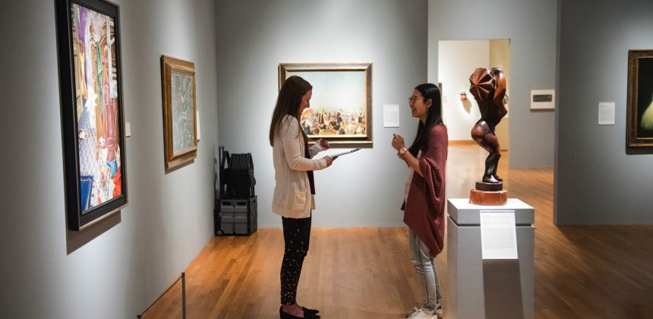
Problem - Current Solution
View artwork
Read accompanying label
Use Google to do more research

Slide 4
Demo

Slide 5
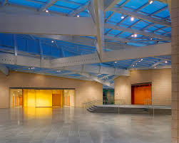
Personas
Community visitors, visiting for pure interest
Students (Duke or other) for exploration or research
Curators at the Nasher charged with curation, interpretation, and showcasing of exhibits
Notes:
Community visitors, visiting for pure interest Students (Duke or other) for exploration or research Curators at the Nasher who are content specialists charged with the museum’s collections and involved with the interpretation of heritage material, as well as in charge of adding new pieces and exhibits to the displays.

Slide 6
What We’ve Learned
User Side: Students, visitors, and curators on campus generally preferred a more technological/ digitized component to exhibits, to really bring the pieces to life. The application could put artifacts in the context of their surroundings, shedding greater light on both the art piece and the historical background of the exhibit itself.
Client Side: Gaining context about art pieces can be extraordinarily difficult, especially when it comes to exhibitions from ancient times, and presenting that to visitors of the Nasher can be even more challenging.

Slide 7
Impact
Benefits:
More engagement within “Art of the Americas”
Can be used as informational tool for any gallery
Easy for curators to provide accompanying information for artwork
Negatives:
Insertion of technology within gallery may be distracting
Visitors may still want more information
Notes:
Edward
Impacts. one possible positive and one possible negative impact of your app

Slide 8
Concerns
Technical Aspects
3D models
Project scope
Vaguely defined
Difficult to estimate

Slide 9
Looking forward to pushing our concept to completion!
Thanks for listening.

